Slide 1

Smart Temperature Monitoring System
Project ID : 2022-05

Slide 2




Team Members
Munasinghe M. W. S. S. M. T. M. B
IT19162706
Bogahawatte H.M.J.J
IT19237978
Aththanayake A. B. P. S
IT19176666
Halpe H.M.P.H
IT19017716
Smart Temperature Monitoring System

Slide 3
Introduction
This project focuses on a temperature monitoring system using a raspberry pi device.
This system consists two main components
Temperature gauge to display the effect of the temperature.
A dashboard with past data visualizations along with future predictions.
Smart Temperature Monitoring System

Slide 4
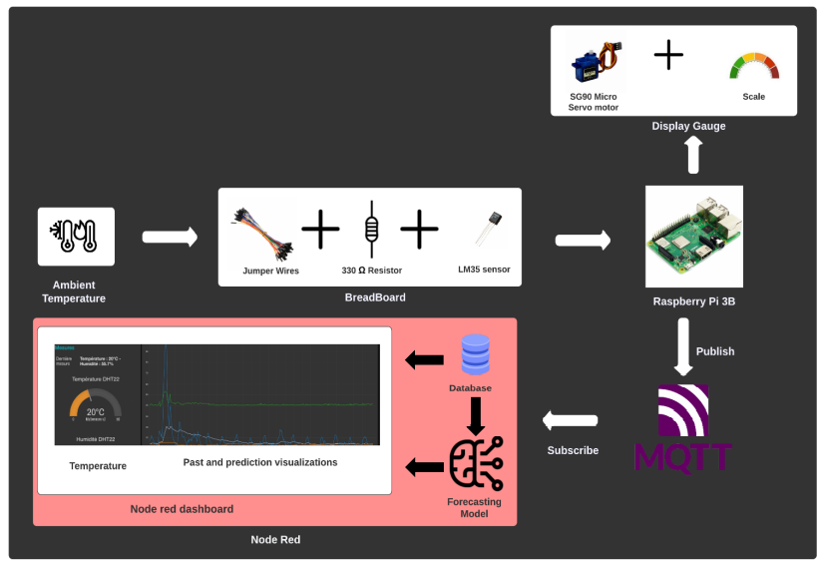
Overall Architecture Diagram
2.2k resistor
DSB18B20 sensor
Smart Temperature Monitoring System

Slide 5
Overall Architecture Diagram
Raspberry pi will act as the center point which will carry out all the tasks
The temperature sensor will be used to get the input for the monitoring system
Temperature read by the sensor and will be sent to the raspberry pi through the connected breadboard
Based on the reading of the sensor the axel of the actuator will be moved on the gauge
Afterwards the raspberry pi will act as a publisher and will publish the data through a cloud hosted broker.
The captured data will be stored in database and then visualized.
The data of past 12 months along with prediction values for 12 months ahead will be visualized in the dashboard
Smart Temperature Monitoring System

Slide 6
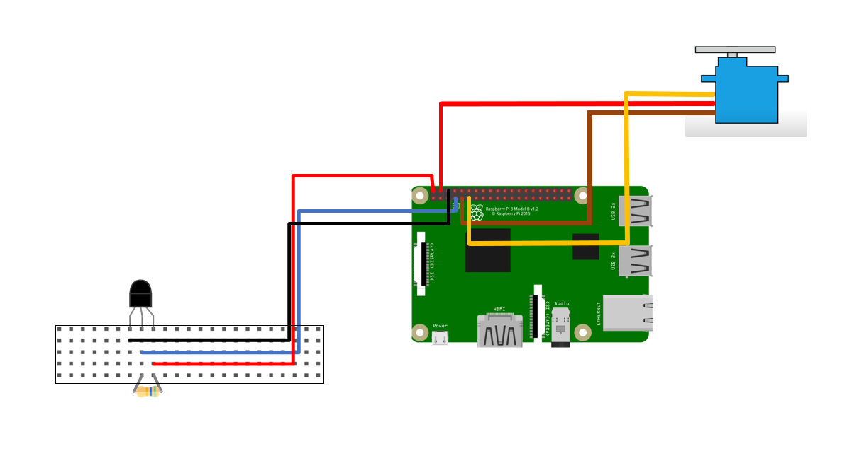
Components used and Circuit
DSB18B20 temperature sensor
SG90 Servo motor
Raspberry pi 3B board
2.2k resistor
Jumper wires
2
3
1
4
Smart Temperature Monitoring System

Slide 7
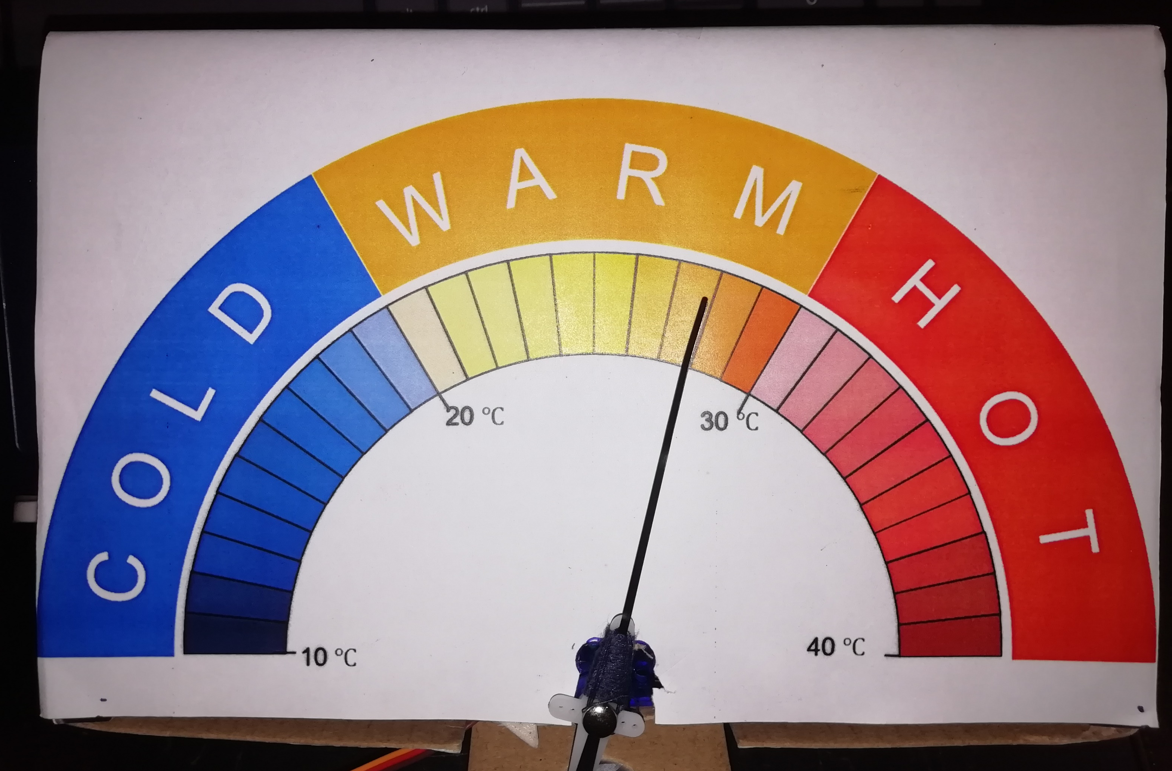
Display Gauge
The display gauge is built to show the effect (Cold , warm or hot) of the temperature based on the read temperature from the sensor.
If the temperature is less than 20 Celsius the gauge will move its axel to cold region and will display the temperature value as well.
If temperature is between 20 and 30 the axel will move to the warm region and if the temperature is greater than 30 it will move to the hot region.
A SG90 micro servo motor is used for this purpose.
The motor is programmed to move its axel based on the sensor reading using python
Smart Temperature Monitoring System

Slide 8
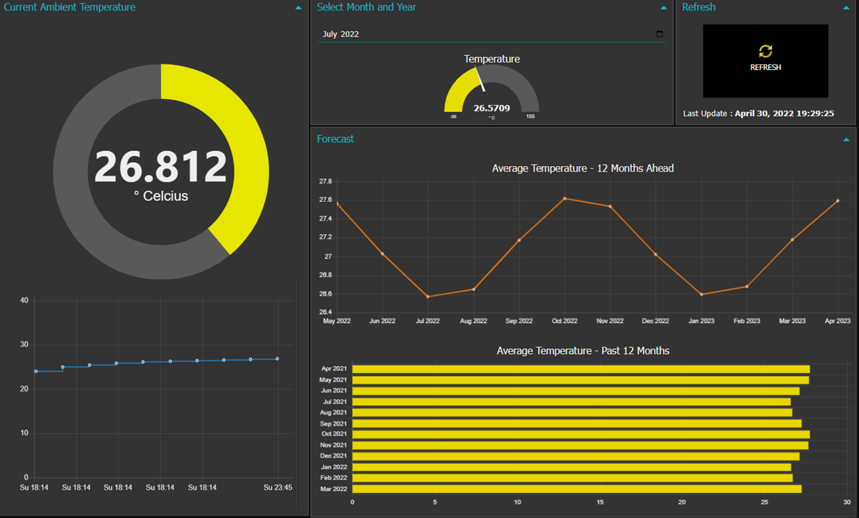
Node-red Dashboard
Smart Temperature Monitoring System

Slide 9
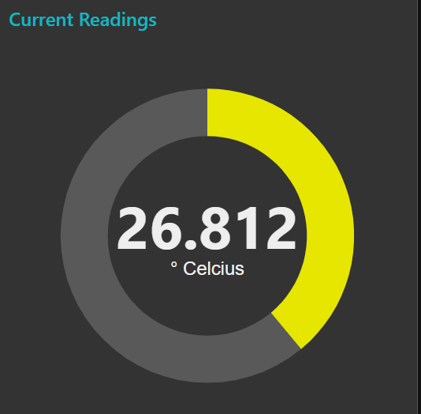
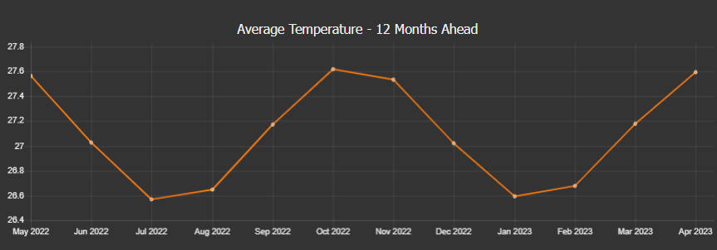
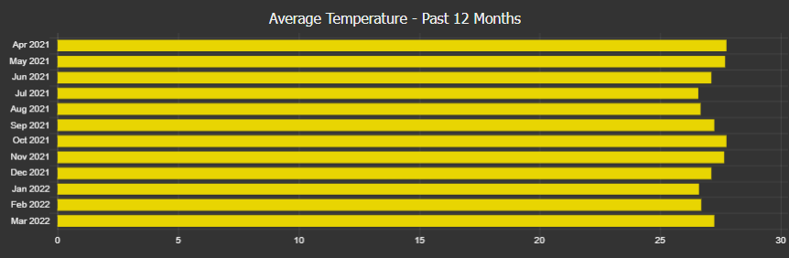
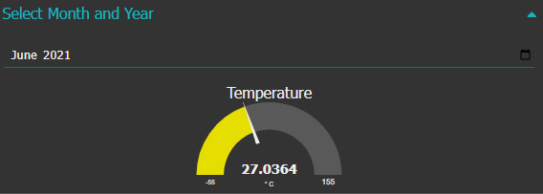
Node-red Dashboard
The dashboard consists of 4 main components
Current temperature Gauge
Past data visualization
Temperature prediction visualization
Temperature gauge visualization based on user selection
Smart Temperature Monitoring System

Slide 10
Node-red Dashboard
Current temperature Gauge
Displays the current temperature received from the sensor
Past and prediction data visualization
The past data are stored in a MySQL database
Data is retrieved from the database to the node red dashboard with the help of the MySQL node in node red and in transformed using a function node.
Temperature gauge visualization based on user selection
Using the data stored in the MySQL database data will be retrieved based on the user input.
Users can select a specific month and a year with the help of the date picker provided and based on the input a query is executed at the database using MYSQL node and will retrieve the relevant temperature value.
Smart Temperature Monitoring System

